Slide 1
A core Course on Modeling
Introduction to Modeling
0LAB0 0LBB0 0LCB0 0LDB0
c.w.a.m.v.overveld@tue.nl
v.a.j.borghuis@tue.nl
S.3

Slide 2
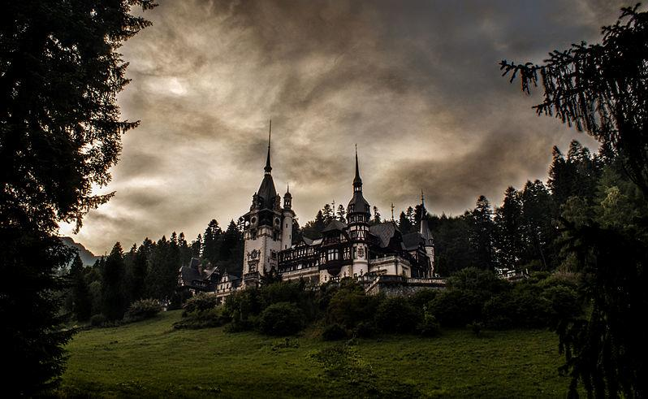
Three questions help to find
the purpose of a model
2
http://commons.wikimedia.org/wiki/File:Fairy_tale_castle.jpg
Notes:
2
As everybody knows, entering a fairy tale castle can be quite a challenge. The gate keeper, commonly a trained body builder with bad manners and little patience, asks three questions, and only when all three are answered correctly, the visitor may enter. In our case, the fairy tale castle is the purpose of the mathematical model we intend to develop. This purpose may be hidden, and we may need to put effort in unveiling it. Three questions will help us in doing so.

Slide 3
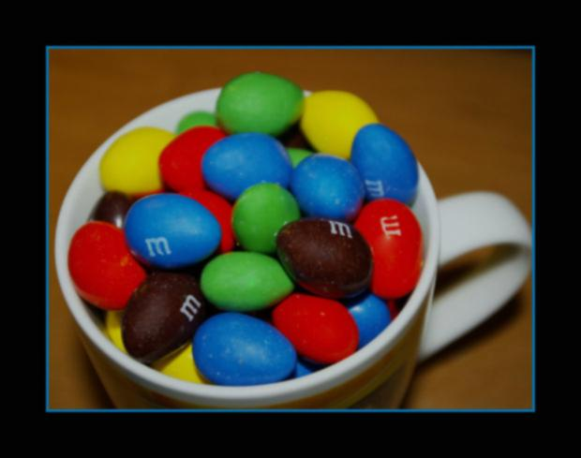
Question1:
Is there something to choose?
If so, what?
3
Notes:
3
The first question is: is there something to choose, and if so: what? In the menu and agenda examples we saw earlier, it is obvious that choosing is essential for working with the models. These models are all about chosing. For mathematical models, such as those used in compiling weather maps, however, there are no free inputs: the user of a weather model is not in a position to express his preferences for one weather type over another. On the other hand, a flight simulator – which is essentially a mathematical model of the movements of an aircraft - offers an imitated control lever and other input devices to manoeuvre the plane. Some models help to make decisions by showing the consequences of various options before one of them is effectuated. A designer of electronic equipment, for instance, may use a model to seek which type of transistor he should use in order to achieve a desired amplification gain.

Slide 4
Question2:
Do we need numerical output?
If so, what do these numbers mean?
4
http://commons.wikimedia.org/wiki/File:Sunset_with_railroad_signal.jpg
Notes:
4
The second question is: should the model produce any numerical output, and if so, what should the numbers mean? A model that predicts when, say, we will run out of fossile fuel is next to worthless if it cannot give an expected date. The film agenda gives information about the starting time and the length of each of the films, which are also examples of numerical output. A model that should convince us that a railroad signaling system is safe, however, is supposed only to report ‘false’ if a potentially dangerous configuration is detected and ‘true’ otherwise. Notice: even if a mathematical model is not set up for its numerical output, it still may deal with numerical values internally

Slide 5
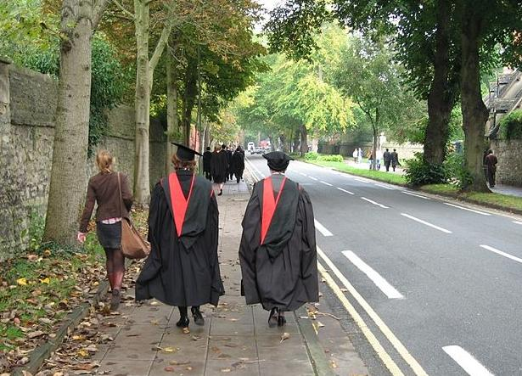
Question3:
Should the model yield knowledge or value?
What knowledge, or what value?
5
http://commons.wikimedia.org/wiki/File:Academic_dress_Oxford_walking.jpg
Notes:
5
The third and last question is: should the model yield knowledge or value, and what knowledge or what value should be obtained? A model, for instance, used by a company to help decide what amount of products should be manufactured aims to optimize the profit of that company. Profit is an example of value, and so are safety, comfort, health, sustainability (in the form of produced waste or consumed energy), et cetera. On the other hand, the ancient Greek mathematician Eratosthenes set up a model involving the earth, sun rays and shadows to find the radius of the earth. The outcome of this model was a novel piece of knowledge, but it did not give rise to any economical or social value. The menu and film agenda models we saw earlier are there to help obtaining a helathy and teasty meal, and an entertaining evening. These also are values rather than fragments of knowledge.

Slide 6
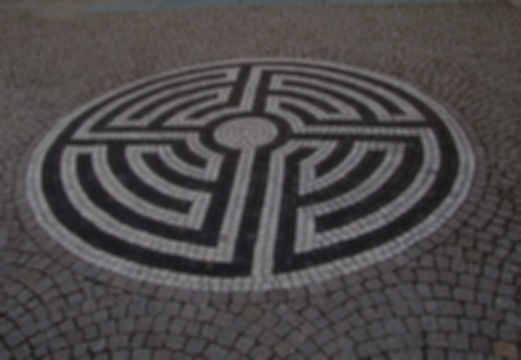
QUIZ
‘Value’ is not always about money. People sometimes use money, however, as a way to compare the value of things.
How could you estimate the (negative) value of someone having influenza?
Notes:
6
The third and last question is: should the model yield knowledge or value, and what knowledge or what value should be obtained? A model, for instance, used by a company to help decide what amount of products should be manufactured aims to optimize the profit of that company. Profit is an example of value, and so are safety, comfort, health, sustainability (in the form of produced waste or consumed energy), et cetera. On the other hand, the ancient Greek mathematician Eratosthenes set up a model involving the earth, sun rays and shadows to find the radius of the earth. The outcome of this model was a novel piece of knowledge, but it did not give rise to any economical or social value. The menu and film agenda models we saw earlier are there to help obtaining a helathy and teasty meal, and an entertaining evening. These also are values rather than fragments of knowledge.

Slide 7
Summary:
Is there something to be chosen? If so, what?
Should there be a numerical outcome? If so, what?
Should the model yield value or knowledge? What value or knowledge?
Notes:
7
Remember that, prior to answering these questions, you should be aware of the stakeholders for whom the model is intended.
In most cases, modeling will be intended to serve one of the purposes to be discussed next.

Slide 8
choose? | output numbers? | value / knowledge ? | purposes
yes | yes | knowledge | predict (2)
yes | yes | value | optimize
yes | no | knowledge | analyse, explore
yes | no | value | decide, specify
no | yes | knowledge | predict (1), compress
no | yes | value
no | no | knowledge | explain, abstract, unify, verify, communicate, train
no | no | value | control
Notes:
8
The three questions allow 8 different combinations of answers. Most of these combinations correspond to purposes that often occur in practice. These purposes have specific names, seen in the table. In the sequel we will explain each of these.

Slide 9
Examples
Why does a yoyo ...
… climb the rope?
… go down slower than with 9.8 m/s²?
… attract so much fans?
Explanation: why is something as it is?
Notes:
9

Slide 10
QUIZ
Examples
Why does a yoyo climb the rope?
Why does a yoyo ...
… climb the rope?
… go down slower than with 9.8 m/s²?
… attract so much fans?
Explanation: why is something as it is?
Notes:
10

Slide 11
Examples
2. When will the yoyo ...
… reach its highest point?
… stop yoyoing?
… get out of fashion?
Prediction (1): at what time will X happen?
Notes:
11

Slide 12
Examples
3. What will happen if ...
… I pull up the yoyo rope later?
… the diameter of the yoyo increases?
… a new toy comes to the market?
Prediction (2): what will happen if X?
Notes:
12

Slide 13
Examples
4. How can I organize data?
r₁(cm) r₂(cm) m(kg) a(m/s²)
2.5 ± 0.1 5 ± 0.2 0.2 ± 0.05 3.3 ± 0.2
2.0 ± 0.1 8 ± 0.1 0.3 ± 0.05 1.4 ± 0.5
2.5 ± 0.05 5.1±0.1 0.5 ± 0.02 3.2 ± 0.1
3.0 ± 0.2 6 ± 0.1 0.3 ± 0.05 3.2 ± 0.4
1.0 ± 0.1 10 ± 0.2 0.6 ± 0.05 0.2 ± 0.05
5 ± 0.1 1 ± 0.1 0.1 ± 0.05 9.8 ± 0.3
4 ± 0.2 4 ± 0.2 0.3 ± 0.05 7.4 ± 0.2..
r₂
r₁
Notes:
13
First start film (blue button,. lower right, on world record largest yoyo) Entire movie lasts 3 minutes – perhaps interrupt halfway
Also compare to own small yoyo
observation 1: perhaps m is irrelevant, since 1st and 3rd experiment give same a with different m’s
observation 2: perhaps ratio r1/r2 is the only thing that matters, because 1st and 4th experiment give same a with different r1 and r2, but the same r1/r2

Slide 14
Examples
4. How can I organize data?
r₁(cm) r₂(cm) m(kg) a(m/s²) r₂/r₁
2.5 ± 0.1 5 ± 0.2 0.2 ± 0.05 3.3 ± 0.2 2
2.0 ± 0.1 8 ± 0.1 0.3 ± 0.05 1.4 ± 0.5 4
2.5 ± 0.05 5.1±0.1 0.5 ± 0.02 3.2 ± 0.1 2
3.0 ± 0.2 6 ± 0.1 0.3 ± 0.05 3.2 ± 0.4 2
1.0 ± 0.1 10 ± 0.2 0.6 ± 0.05 0.2 ± 0.05 10
5 ± 0.1 1 ± 0.1 0.1 ± 0.05 9.8 ± 0.3 0.2
4 ± 0.2 4 ± 0.2 0.3 ± 0.05 7.4 ± 0.2 1.
Notes:
14
Stipulate that the suggestion to look at the ratio r2/r1 is ‘sheer luck’. Also, the idea to ignore m is sheer luck (although from dimension analysis it is obvious)

Slide 15
Examples
4. How can I organize data?
a(m/s²) r₂/r₁
3.3 ± 0.2 2
1.4 ± 0.5 4
3.2 ± 0.1 2
3.2 ± 0.4 2
0.2 ± 0.05 10
9.8 ± 0.3 0.2
7.4 ± 0.2 1
Compression:
how to compactly represent data?
2 4 6 8 10
a = 2g / (2+r₂²/r₁²)
a (m/s²)
2 4 6 8 10
r₂/r₁
Notes:
15

Slide 16
Examples
5. Focus on what is important:
Is the shape important?
Is the rope quality important?
Is the brand important for the nr. sold yoyo’s?
Abstraction:
restrict to essentials
Notes:
16

Slide 17
Examples
6. Relate similar things:
How does a yoyo resemble a bouncing ball?
How does a yoyo resemble a hula hoop?
How does a yoyo hype resemble any other hype?
Unification:
find commonalities among different things
Notes:
17

Slide 18
Examples
7. Investigate ...
... the changing force in the rope
... the importance of friction
... how yoyo-popularity varies with the season
Analysis:
seek relations within the modeled system
Notes:
18

Slide 19
QUIZ
At some point during the motion of
a yoyo, the force in the rope is zero.
When?
What about the rest of the time?
Examples
7. Investigate ...
... the changing force in the rope
... the importance of friction
... how yoyo-popularity varies with the season
Analysis:
seek relations within the modeled system
Notes:
19

Slide 20
Examples
8. Verify ...
... that the rope will be strong enough
... that energy is conserved
... that marketing laws apply to yoyo sales
Verification:
ascertain the truth of something
Notes:
20

Slide 21
Examples
9. Inform people ...
... how a yoyo works
... how to set up yoyo experiments
... how yoyo hype spreads
Communication:
give comprehensible information
Notes:
21

Slide 22
Examples
10. What options exist for ...
... shapes of yoyo’s
... tricks with yoyo’s
... marketing strategies to spawn hypes
Exploration:
make inventory of options
Notes:
22

Slide 23
Examples
11. How to decide ...
... what diameters to make yoyo fall slower than ... m/s²
... what mass to have a stable yoyo
... what marketing price to get turnover better than X
Decision:
what intervention needed to achieve goal
Notes:
23

Slide 24
Examples
12. How to optimize ...
... diameters to have yoyo rise as far as possible
... mass to have yoyo as stable as possible
... marketing price to get turnover as large as possible
Optimization:
what intervention give maximal result
Notes:
24

Slide 25
Examples
13. How to instruct ...
... manufacturer to assemble a yoyo
... yoyo kid to perform trick X
... shop owner to put yoyo’s on display
Specification:
ensure something will be as it should
Notes:
25

Slide 26
Examples
14. How to ...
... have a robot operate a yoyo
... have an intelligent yoyo stabilize itself
... have shop order yoyo’s dependent on market demand
Control:
adapting behavior to circumstances
Notes:
26

Slide 27
Examples
15. How to ...
... have a yoyo simulator help learning tricks
... have a hype simulator train sales people
...
Train:
familarize trainees with a system
Notes:
27

Slide 28
purpose | choose? | output numbers? | value / knowledge ?
explain | no | no | knowledge
predict (1) | no | yes | knowledge
predict (2) | yes | yes | knowledge
compress | no | yes | knowledge
abstract, unify | no | no | knowledge
analyse | yes | no | knowledge
verify | no | no | knowledge
communicate, train | no | no | knowledge
explore | yes | no | knowledge
decide | yes | no | value
optimize | yes | yes | value
specify | yes | no | value
control | No | no | value
Notes:
28

